Slide 1
Welcome to SegenSolar – Your Solar PV Distributor

Slide 2
GoodWe Use Case
Single Phase and Three Phase

Slide 3
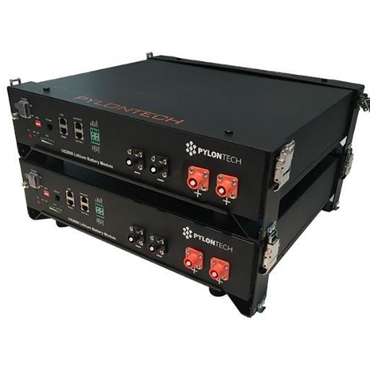
PYLONTECH
Pylontech batteries
Vertical industry integration ensures more than 6000 cycles at 80% DoD or 4500 cycles at 90% DoD
Nominal current of 25A for US2000B
Nominal current of 37A for US3000B
Modular units allow for flexible design and upgrade options
Compatible with GoodWe ES and EM
Simple buckle fixing minimize the installation time and cost
Safety Cert.TÜV CE UN38.3 TLC

Slide 4
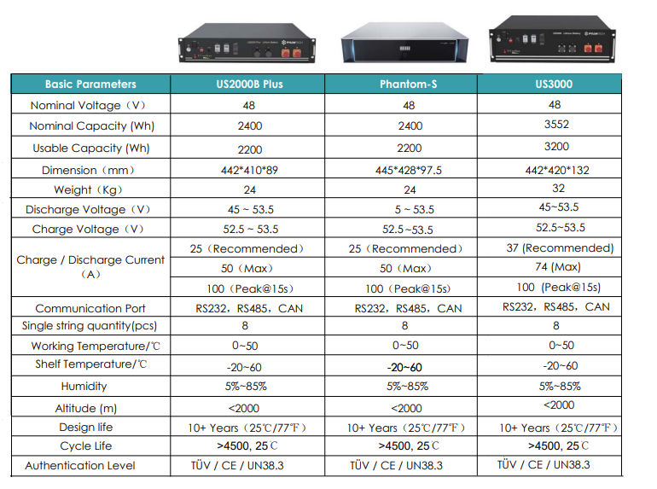
DATA SHEET

Slide 5
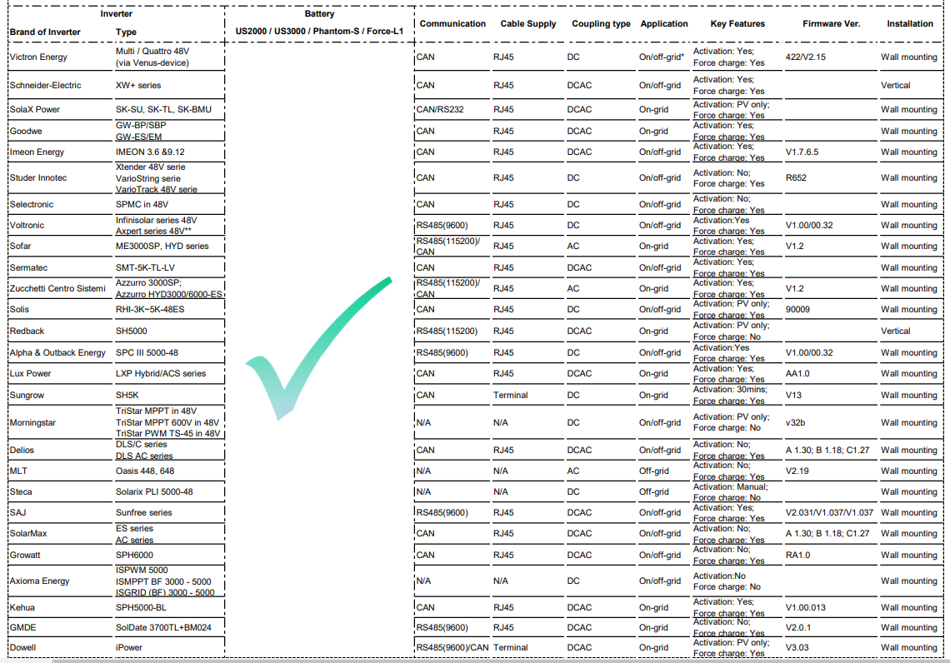

Slide 6
If the scenario requires multiple Pylon battery modules
Internal communication of the Pylon batteries is limited to 8 modules, Pylon can manage battery information for only 8 modules in parallel per inverter with the address allocated automatically.
For larger banks, a Pylontech LV-Hub can be used to connect 5 banks of 8 battereis

Slide 7
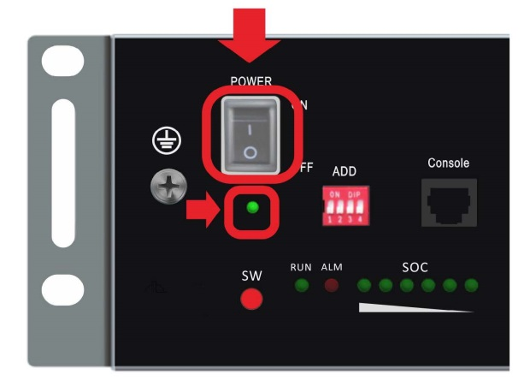
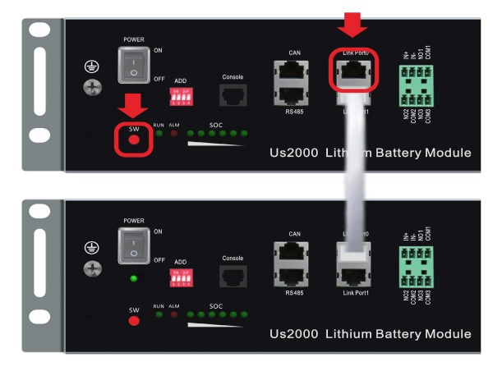
Module Layout
Front Panel
Power Switch
Link Ports

Slide 8
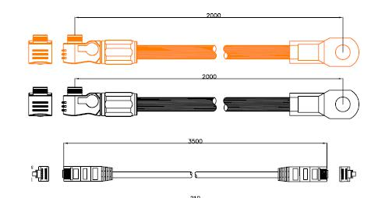
Pylon Cables
Cable accessories included with the battery
Two power cables, one communication cable and one earth cable
Cable Pack, required accessory (Purchased separately)
Two long power cables and one communication cable
NOTE
The Cable pack must be purchased
separately and is not included with
the battery.
The Power cables is rated for a
current rating of 120A.
a Maximum of 5 battery modules can
be connected with one cable pack

Slide 9
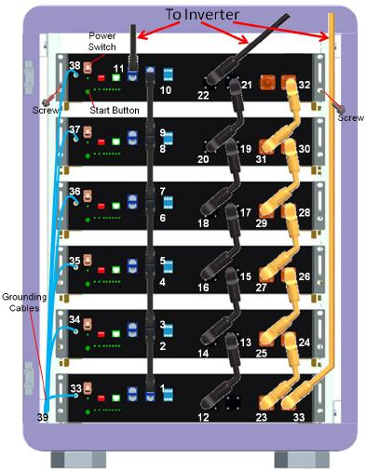
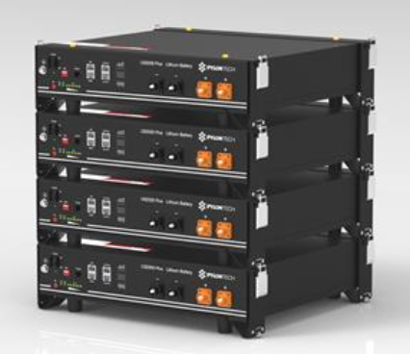
Cabinet / Brackets

Slide 10
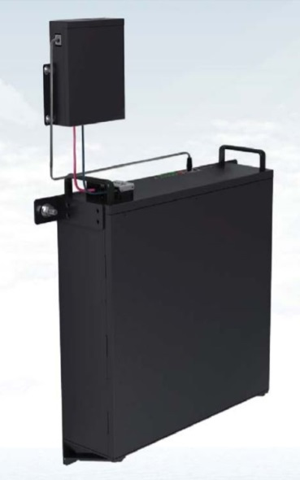
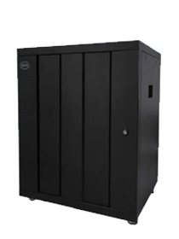
BYD
BYD Batteries
Safe Battery Chemistry – LiFePO4 (Lithium iron phosphate) the thermal runaway temperature is over 480°C
Railway and Automotive Standard Battery – 6+ years track record in the EV market and knowledge in ESS
High Power Output – 1C Nominal and 2C Peak
Easy Installation and Uninterruptible Maintenance – Complete modular design.
Flexible Extension Life Time – Can expand storage at any time
Compatible with GoodWe ES and EM
10 Year Warranty – Covers the battery for 1 full cycle per day for the duration of the warranty

Slide 11
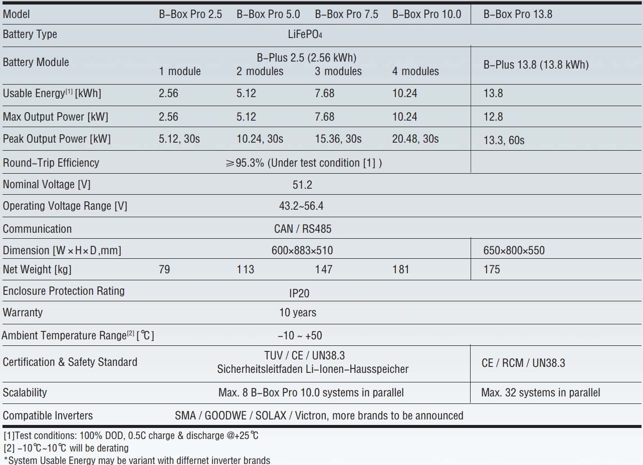
DATA SHEET

Slide 12
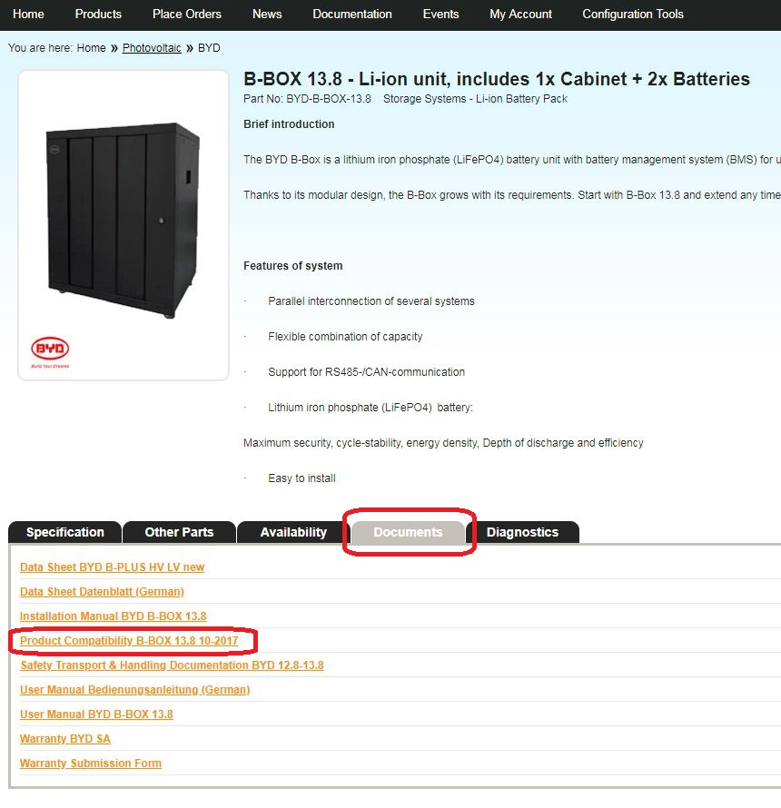
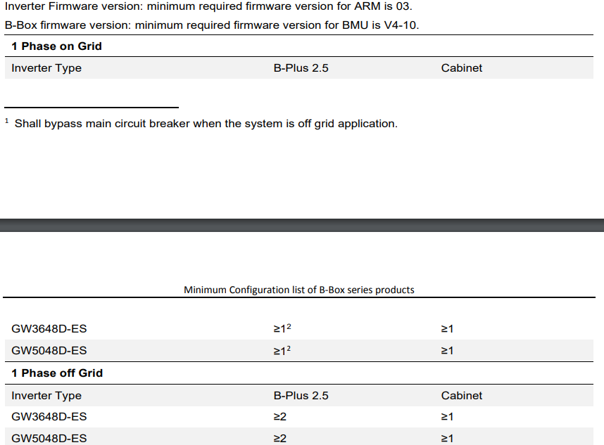
Inverter Compatibility List

Slide 13
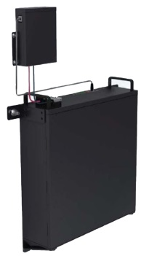
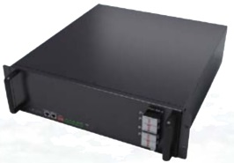
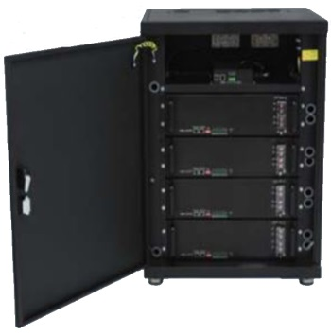
Connecting multiple BYD Modules
B-Box 2.5, 5, 7.5, 10
The BYD BMU can communicate with up to 32 battery modules.
Only two BYD B-Box battery modules can be wall mounted using the Wall Mount Bracket
If more than 3 modules is required the B-Box 10 cabinet must be used and up to maximum of 8 B-Box 10 cabinets can be connected in parallel for a maximum of 80kWh
B-Box 13.8
The B-Box 13.8 can scale up to 32 units in parallel for a total of 441kWh of storage
The Cabinets are fitted with a BMU and bus bars, the internal bus bars are intended for paralleling the modules installed inside the cabinet.

Slide 15
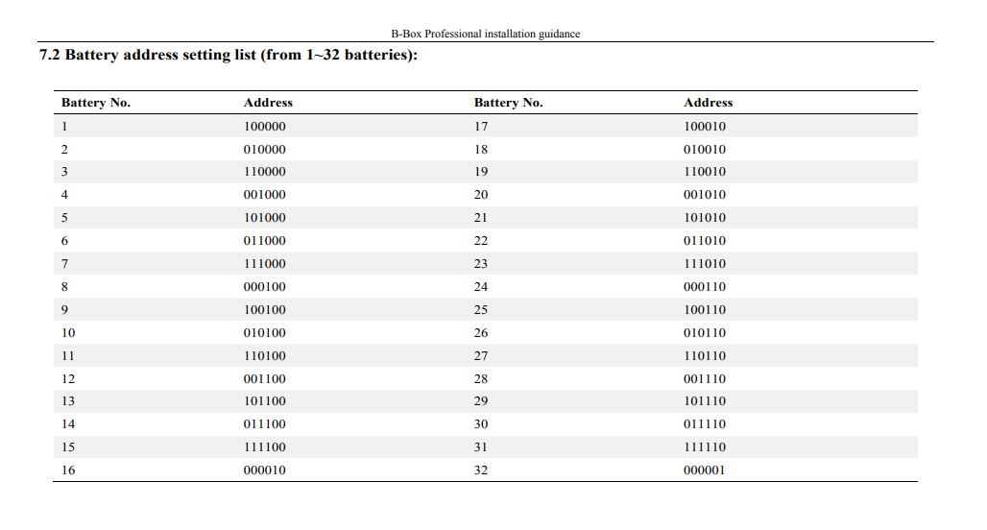

Slide 16
Installation, commissioning and updating firmware

Slide 17
Training Outline
Hybrid inverter overview & main components
Six work modes (scenarios)
Firmware Upgrade
Commission the inverter
Choosing battery type
Wiring
Fault finding
System monitoring
Pylon Application Note and Documents
Warranty

Slide 18
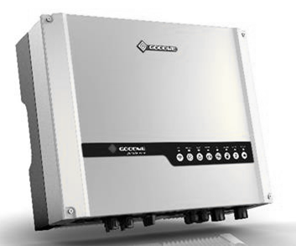
Hybrid inverter Overview

Slide 19
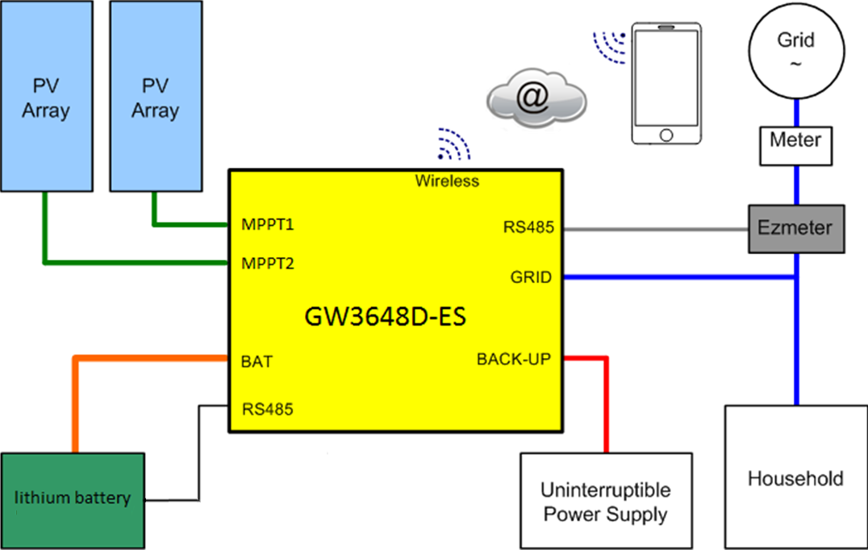
Hybrid Block Diagram

Slide 20
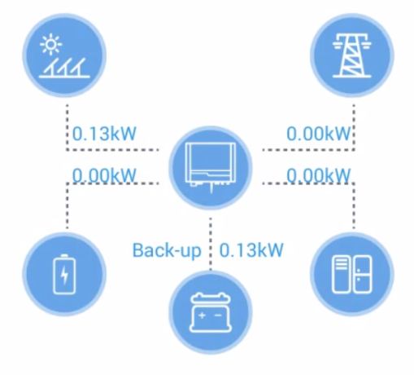

Slide 21
Before Installation
After unpacking, please check the product and packing list, if the product is damaged or there is missing components, please contact Segen.
Before installation, ensure that the battery is turned off.
Double check the polarity, do not swap around the positive and negative leads.
Do not connect the battery directly to AC.
The embedded BMS in the battery is designed for 48VDC, please DO NOT connect batteries in series.
Battery system must be well grounded with a resistance less than 1Ω.
The battery can only be used with inverters approved by pylon.

Slide 22
Battery Connection

Slide 23
EzMeter
Standard accessory with the inverter.
Controls energy exported to the grid and the work modes of the Energy Storage system.
Communicates with the ES inverter via a RS485 cable.
Meter reading NOT used, treat this device as a Black Box.
LED on the bottom left blinks to indicate the system is running
Equipped with CT clamp for current measurement

Slide 24
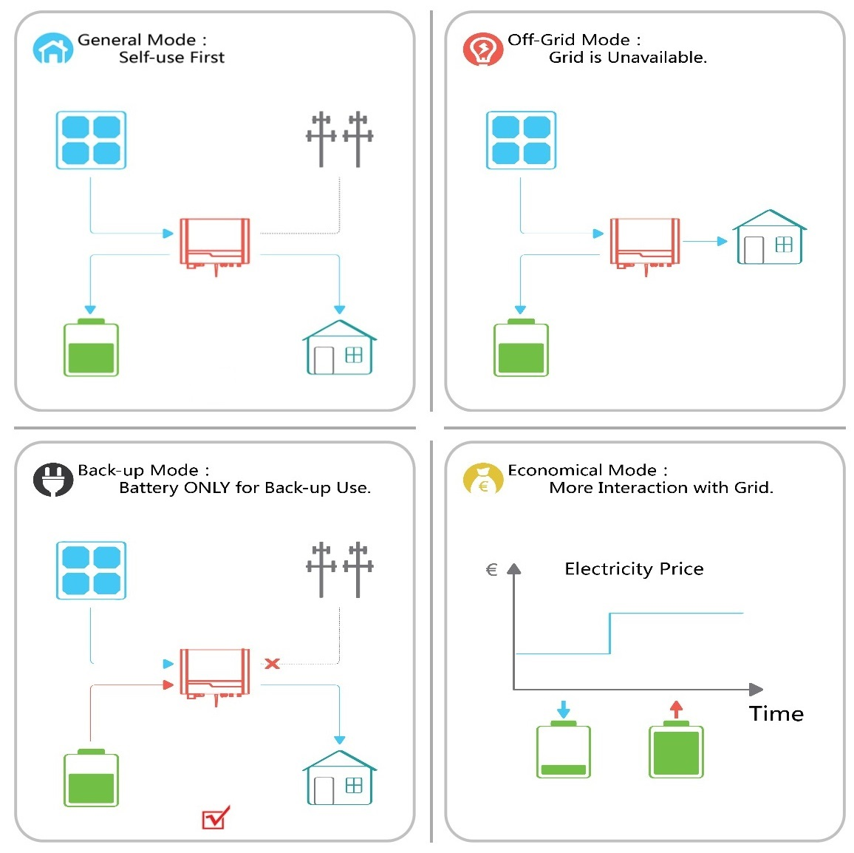
Six Work Modes

Slide 25
Mode 1
Condition: PV ON; Peak Generation
Energy produced by the PV system is for self-consumption optimization. Solar energy will firstly support the load, secondly it will charge the battery and finally export to the grid or draw from the grid, if the load demands more energy.

Slide 26
Mode 2
Condition: Day time, grid fails
The system automatically switches to back-up mode. Solar energy will first support the load connected to the back-up side. If more energy is generated, it will be used to charge the battery.

Slide 27
Mode 3
Condition: System without Battery
Solar energy will first support the load, excess power will be exported to the grid. If generation level is too low, power will be imported from the grid.

Slide 28
Mode 4
Condition: Night-time
ES inverter will discharge the battery to support the load. If the battery stored energy is not enough, the rest of the power will be supplied from the grid.

Slide 29
Mode 5
Condition: Night time, grid fails
Once the grid fails, the system automatically switches to back-up mode. ES inverter will discharge the battery to support the load.

Slide 30
Mode 6
Condition: Use as UPS
If the customer wants to use the system as UPS, the inverter can also be set to charge the battery by the grid.

Slide 31
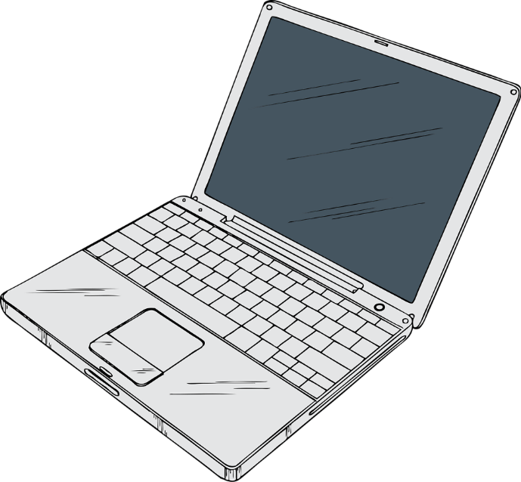
Firmware Upgrade

Slide 32
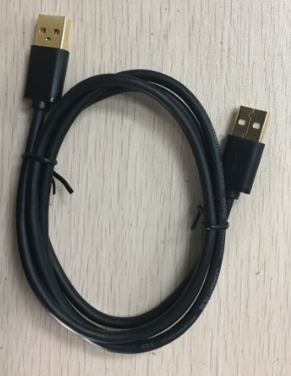
Updating Inverter Firmware
USB Cable
Type A male to Type A male cable

Slide 33
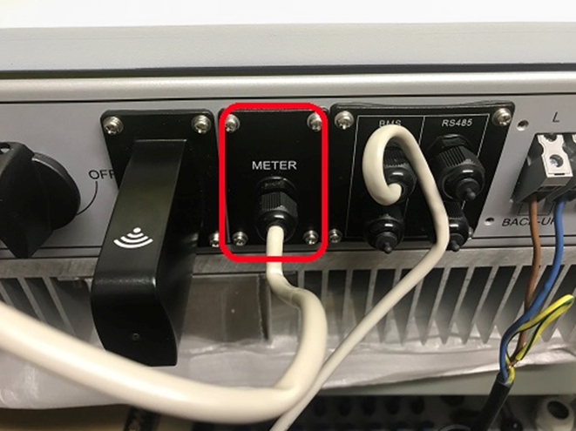
Step 1: Remove the Meter Cover / Antenna block
GoodWe ES
GoodWe EM

Slide 34
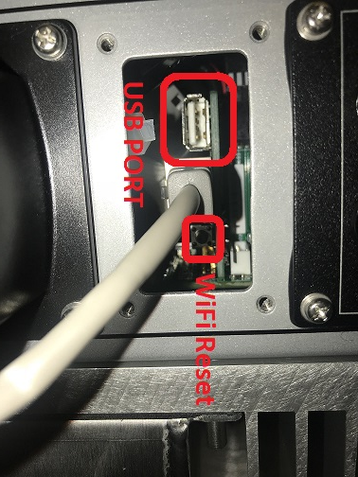
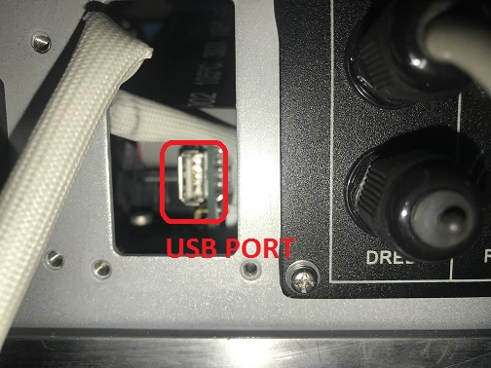
Step 2: Plug the USB cable into the USB port
GoodWe ES
GoodWe EM

Slide 35
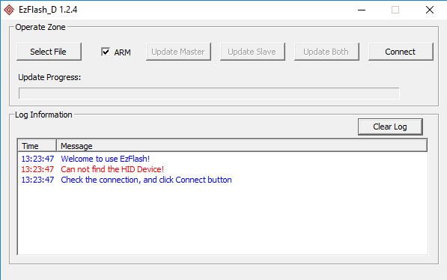
Step 3: Main update
Update tool
Open the EzFlash application
Tick the box marked ARM
Click connect to test inverter connection

Slide 36
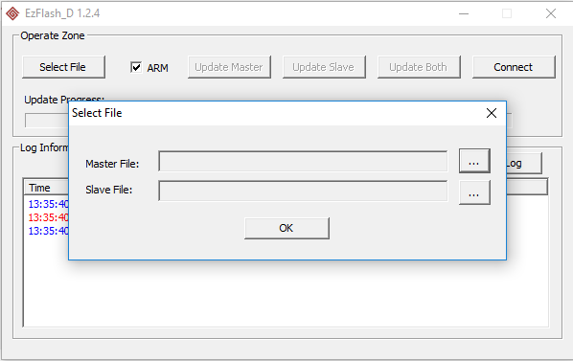
Step 3: Main update
Update tool
Select the slave and master files.
Click the update both button

Slide 37
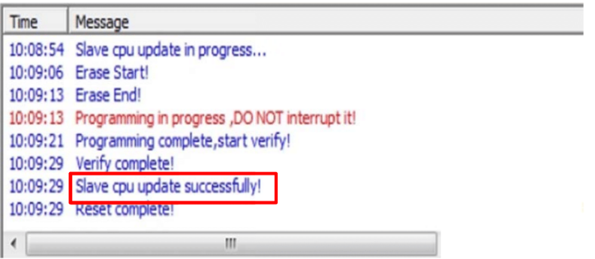
Step 3: Main update
Update tool
Wait for update to complete, it takes about 5 min.

Slide 38
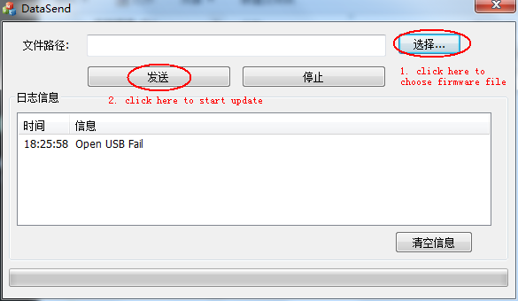
Step 4: Open the software tool
Update tool
Open the email and save the DataSend tool and the .bin file to your computer
Open the DataSend tool.
Click on the first button indicated and select the .bin file saved on your computer.
Click on the second button indicated and wait for the application to display that its completed.

Slide 39
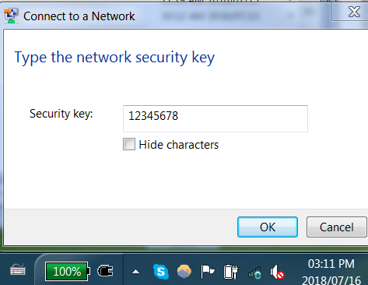
Updating WiFi Firmware
Connect to SolarWiFi and enter the security key

Slide 40
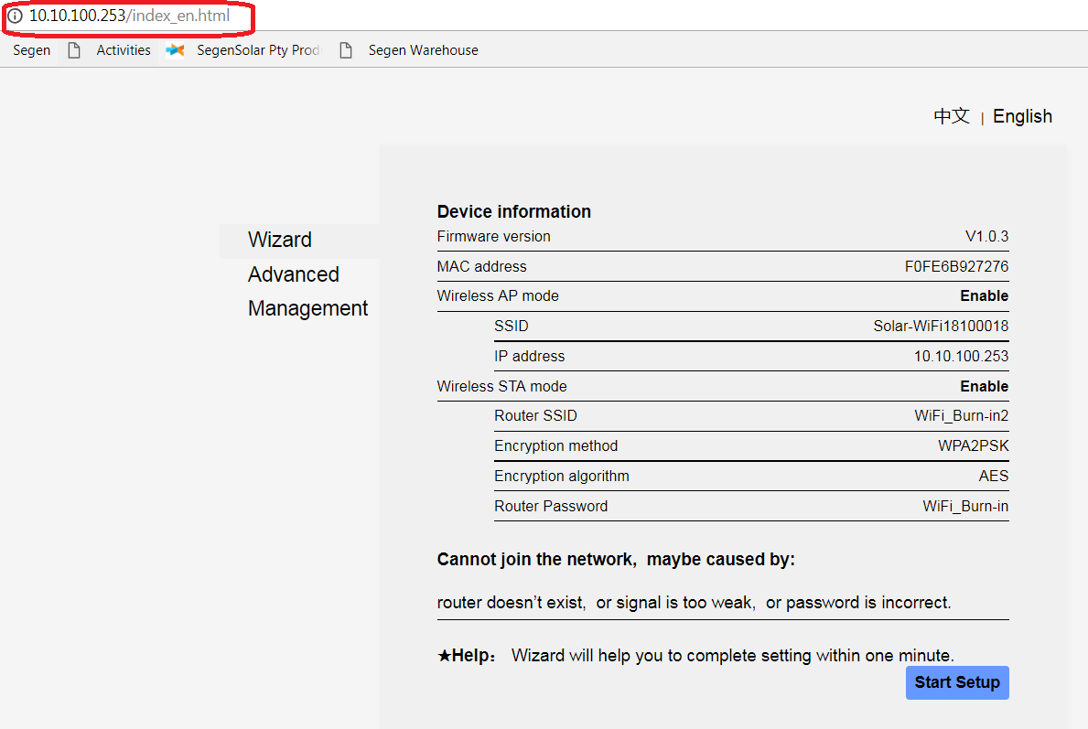

Slide 41
Browser UI
Enter IP address into the browser
10.10.100.253
Click on Management
Check the current version
Select the firmware file
Click on upload and wait for the process to complete

Slide 42
GoodWe EM WiFi Reset

Slide 43
Commission the inverter

Slide 44
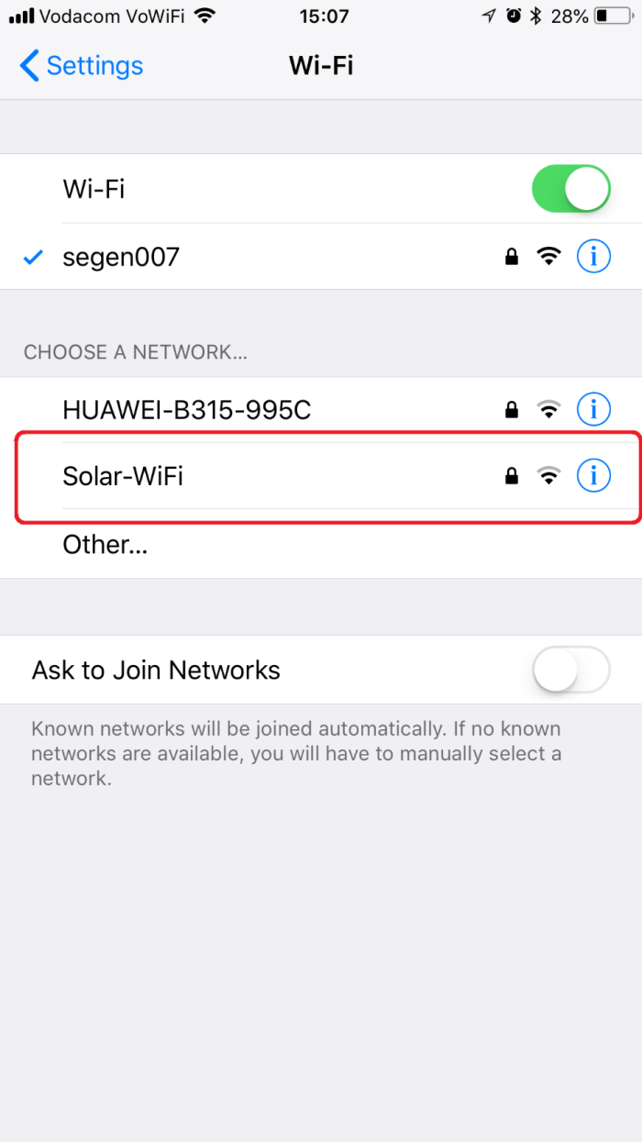
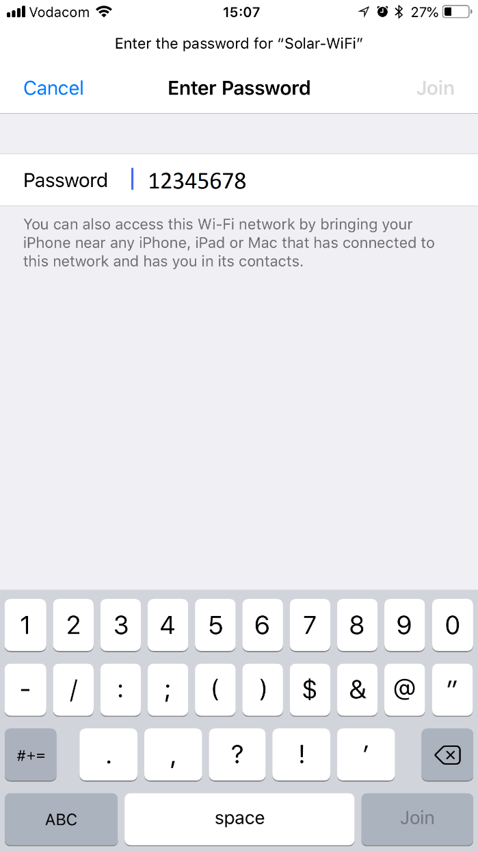

Slide 45
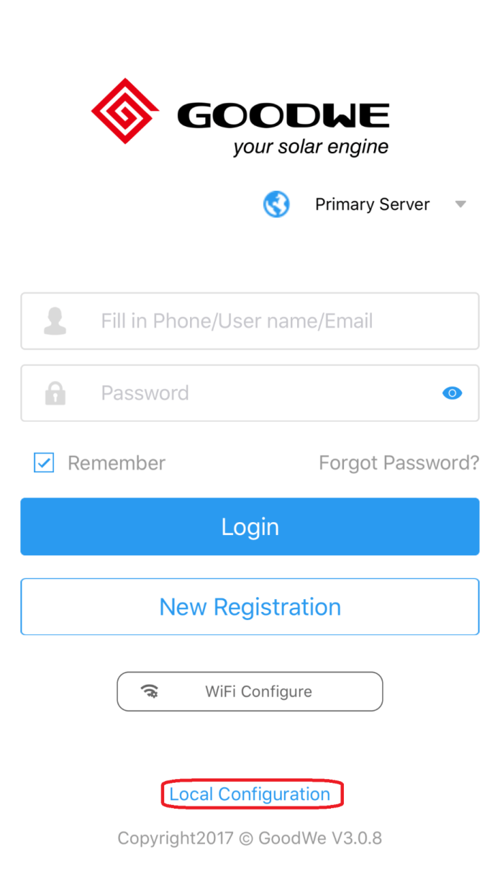
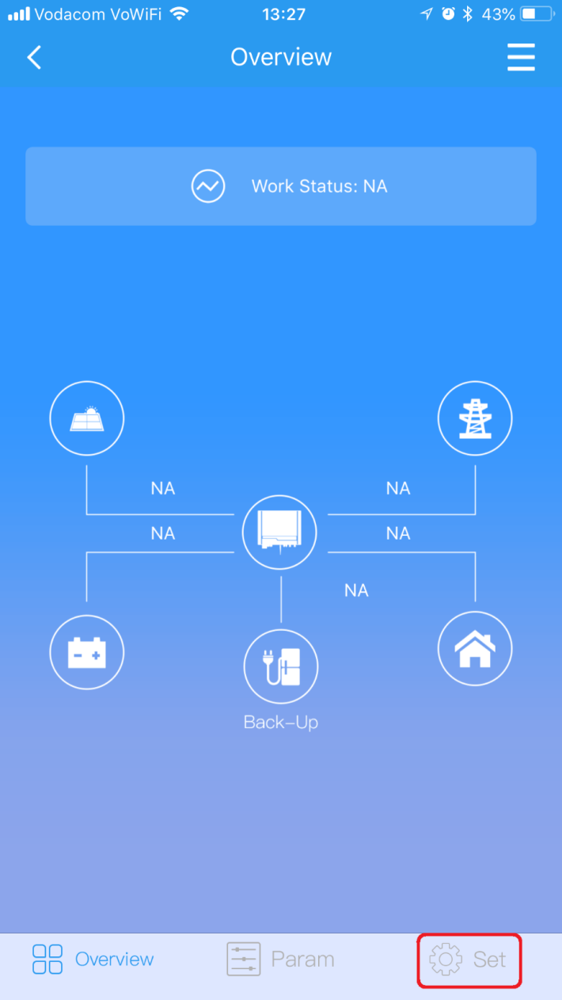
PVmaster APP

Slide 46
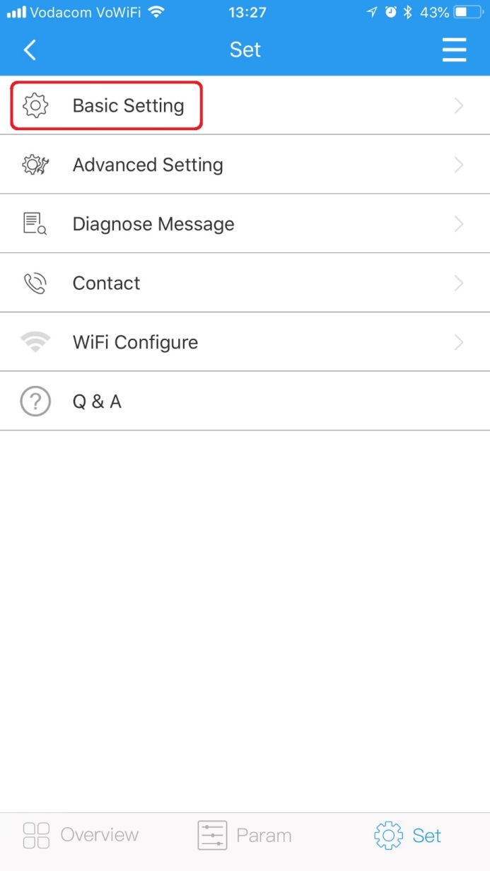
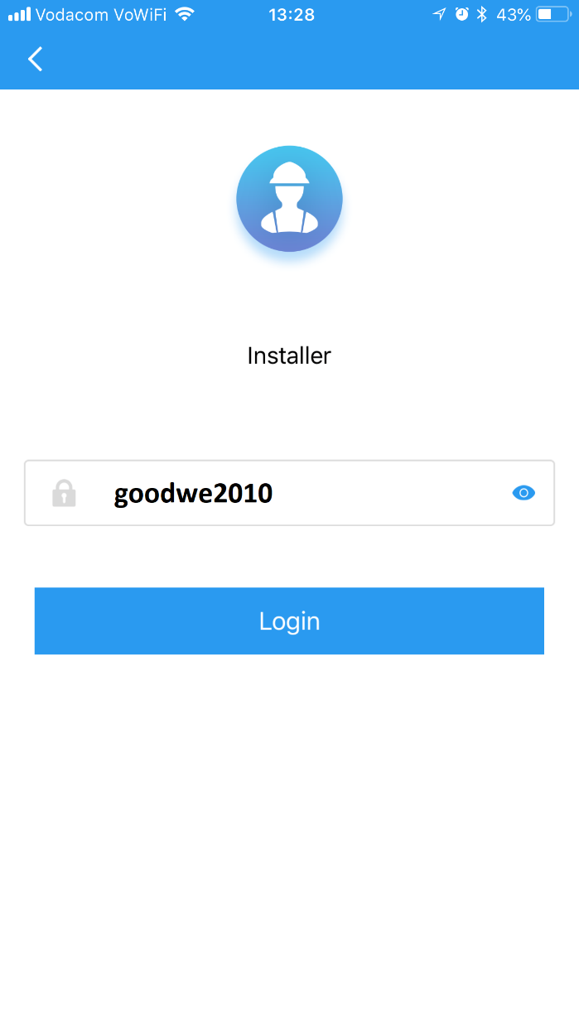

Slide 47
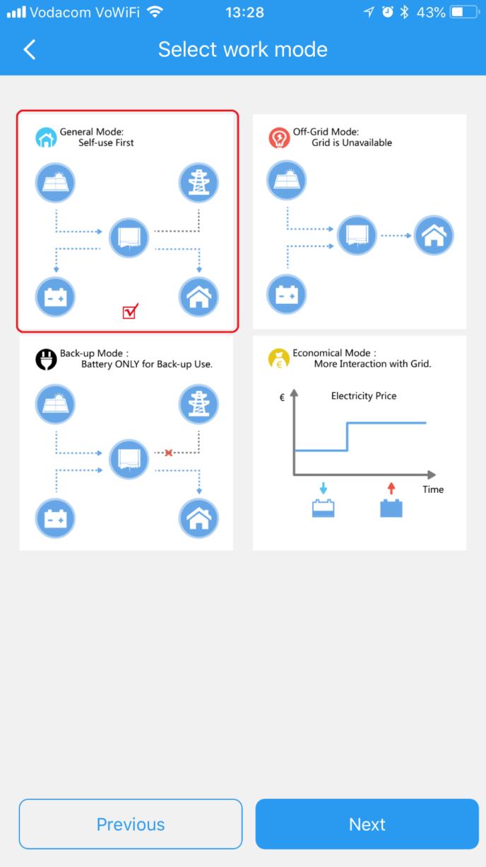

Slide 48
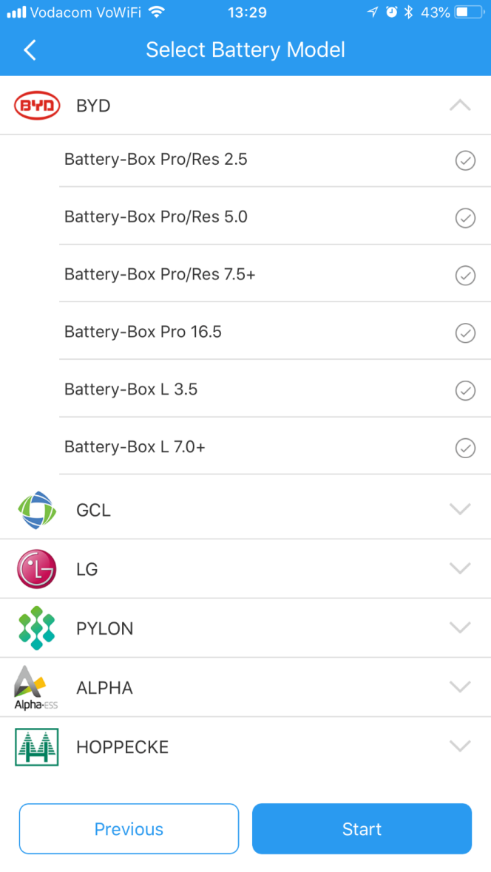

Slide 49
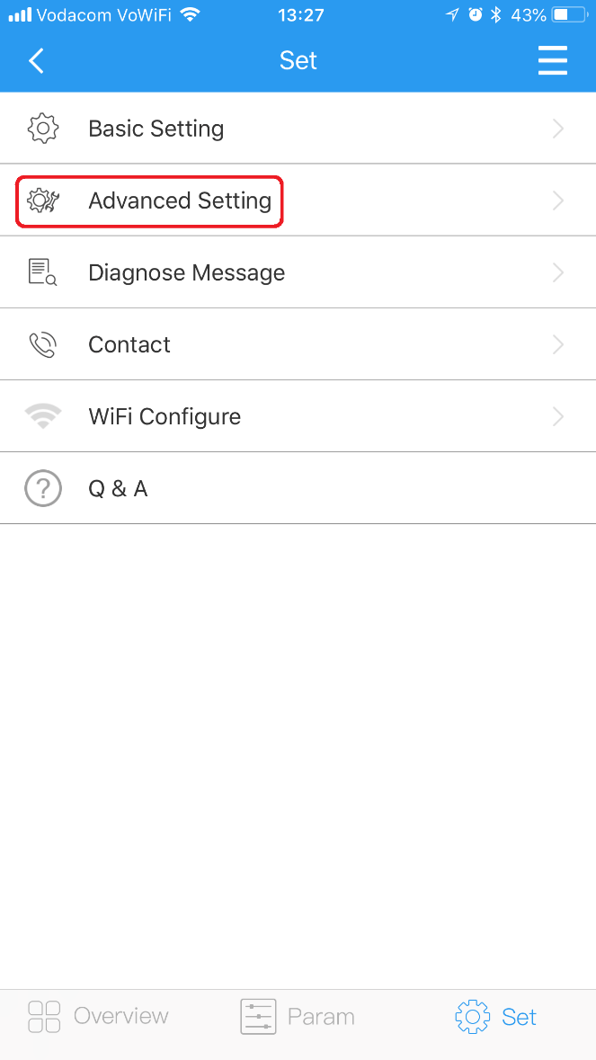
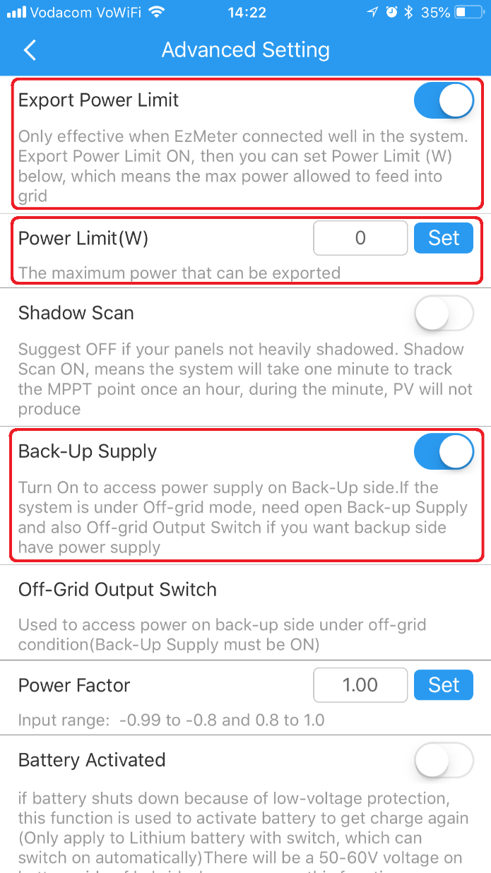

Slide 50
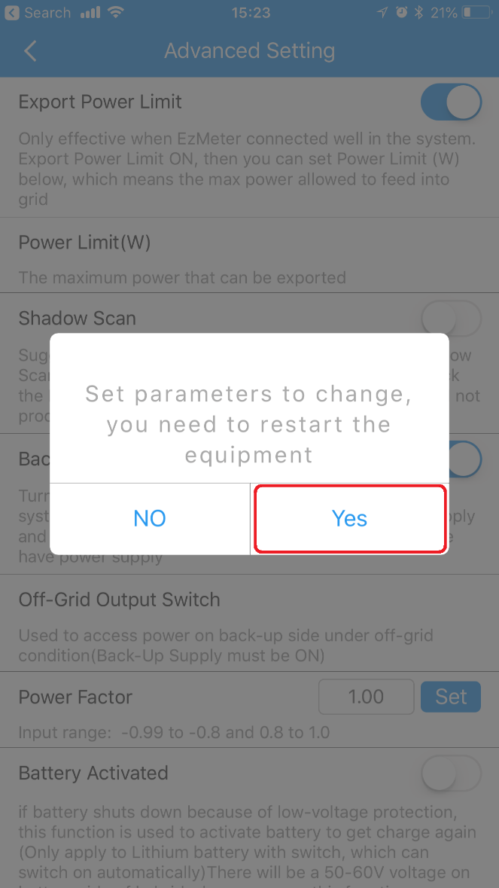

Slide 51
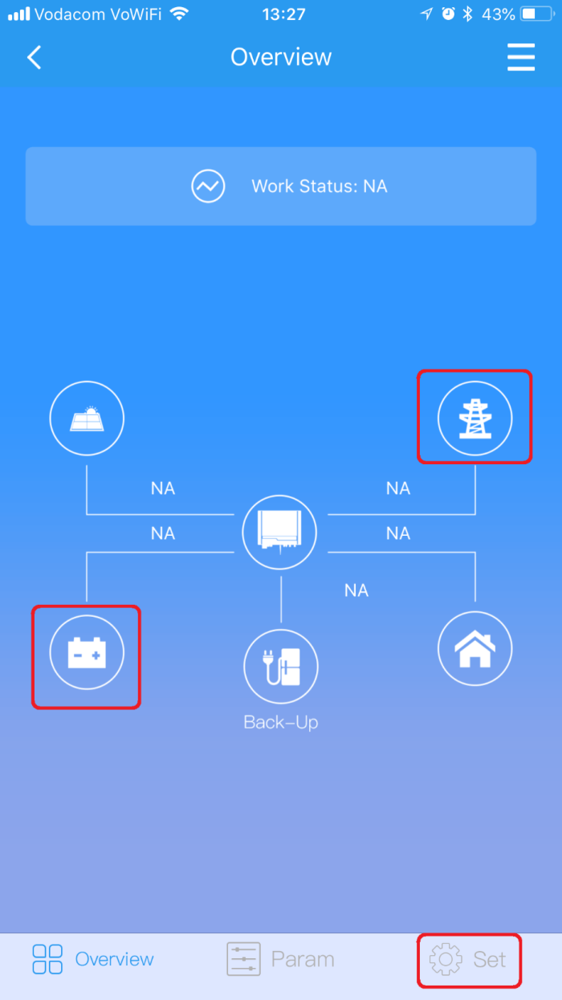

Slide 52
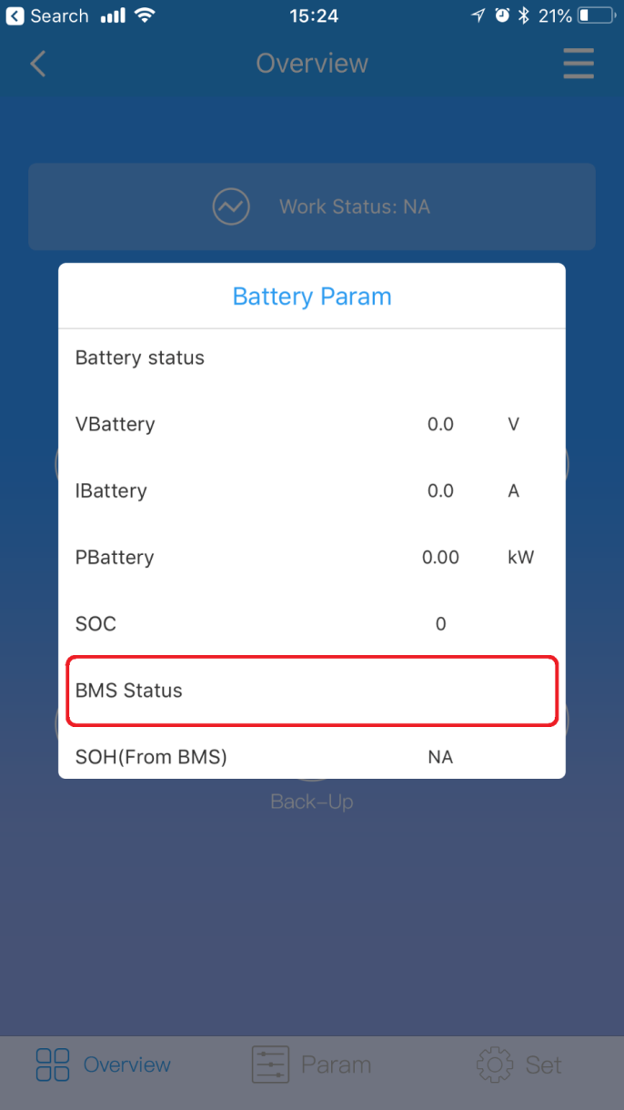
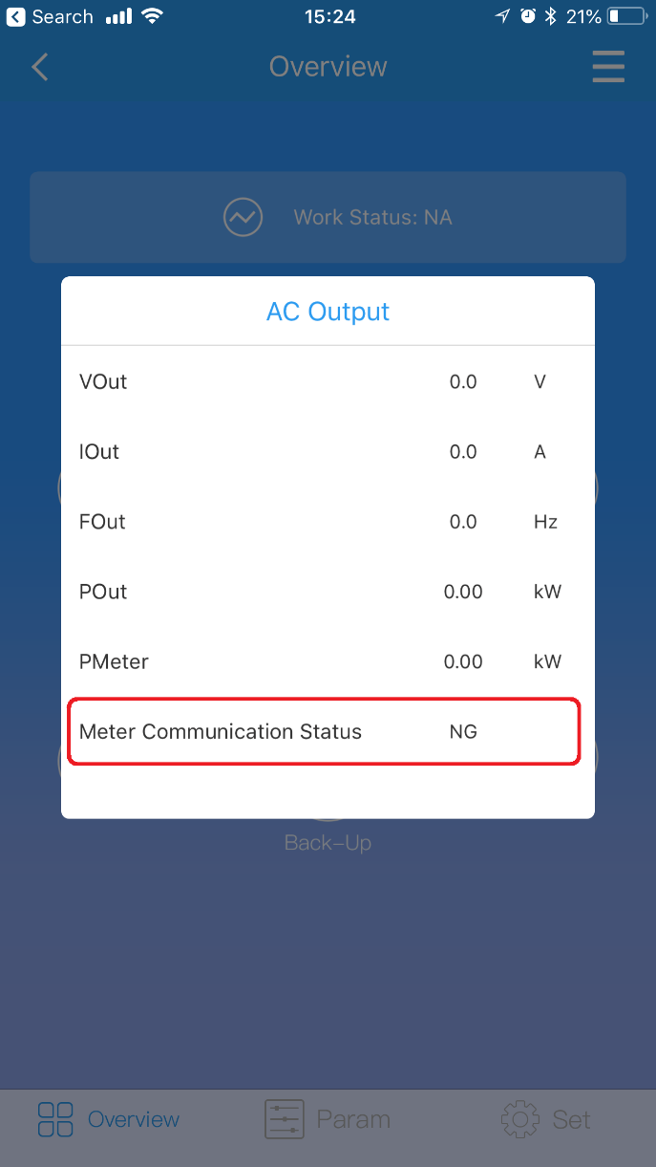

Slide 53
Sizing a Goodwe inverter
Choosing inverter size
Back up-capacity requirements 2.3kVA or 4.6kVA?
2.3kVA suitable for smaller loads: lights, electronics, gate and electric fence.
4.6kVA suitable for larger loads: fridge, microwave, salt aquarium ect.
PV generation capacity will be based on daily usage of the site.
3kVA,3.6kVA and 5kVA capacity available to suit different needs.
The ES inverter may initially seem like a better choice because of the larger back-up supply, however more batteries would be required VS the EM range.

Slide 54
Sizing a Goodwe and Pylon system
Sizing the battery bank
The Goodwe inverter does not make use of the overload capability of the Pylon battery.
The inverter will turn off the back-up circuit should the battery bank nominal current be exceeded.
For the US2000B this current is 25A per battery, 37A for the US3000B.
For the 4.6kVA ES inverter, a minimum of four US2000B or three US3000B units would be needed to get the rated AC output.
For the 2.3kVA only 2 US2000B are needed to reach the max output.
Pylon units can be discharged to 89% of their rated nominal capacity.
When designing a bank, remember to include losses from the inverter and cables.
As can be seen you need twice the battery bank size to run the ES to full capacity. If cost is a concern it may be better to use a EM inverter and have only critical back-up loads.

Slide 55
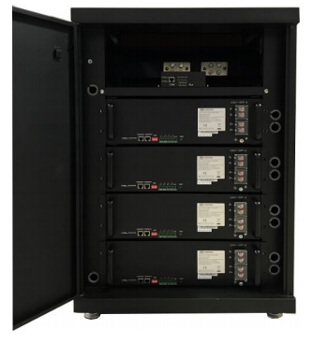
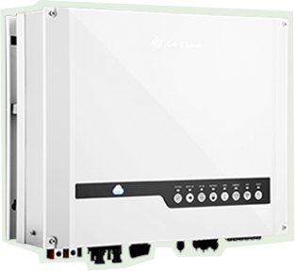
Sizing a Goodwe and BYD system
BYD units have a larger discharge current of 50A
For a EM inverter, only one 2.4kWH battery would be needed
For a ES a minimum of 2 are needed.
BYD may be a better option for the ES inverter as only two units are needed.
+

Slide 56
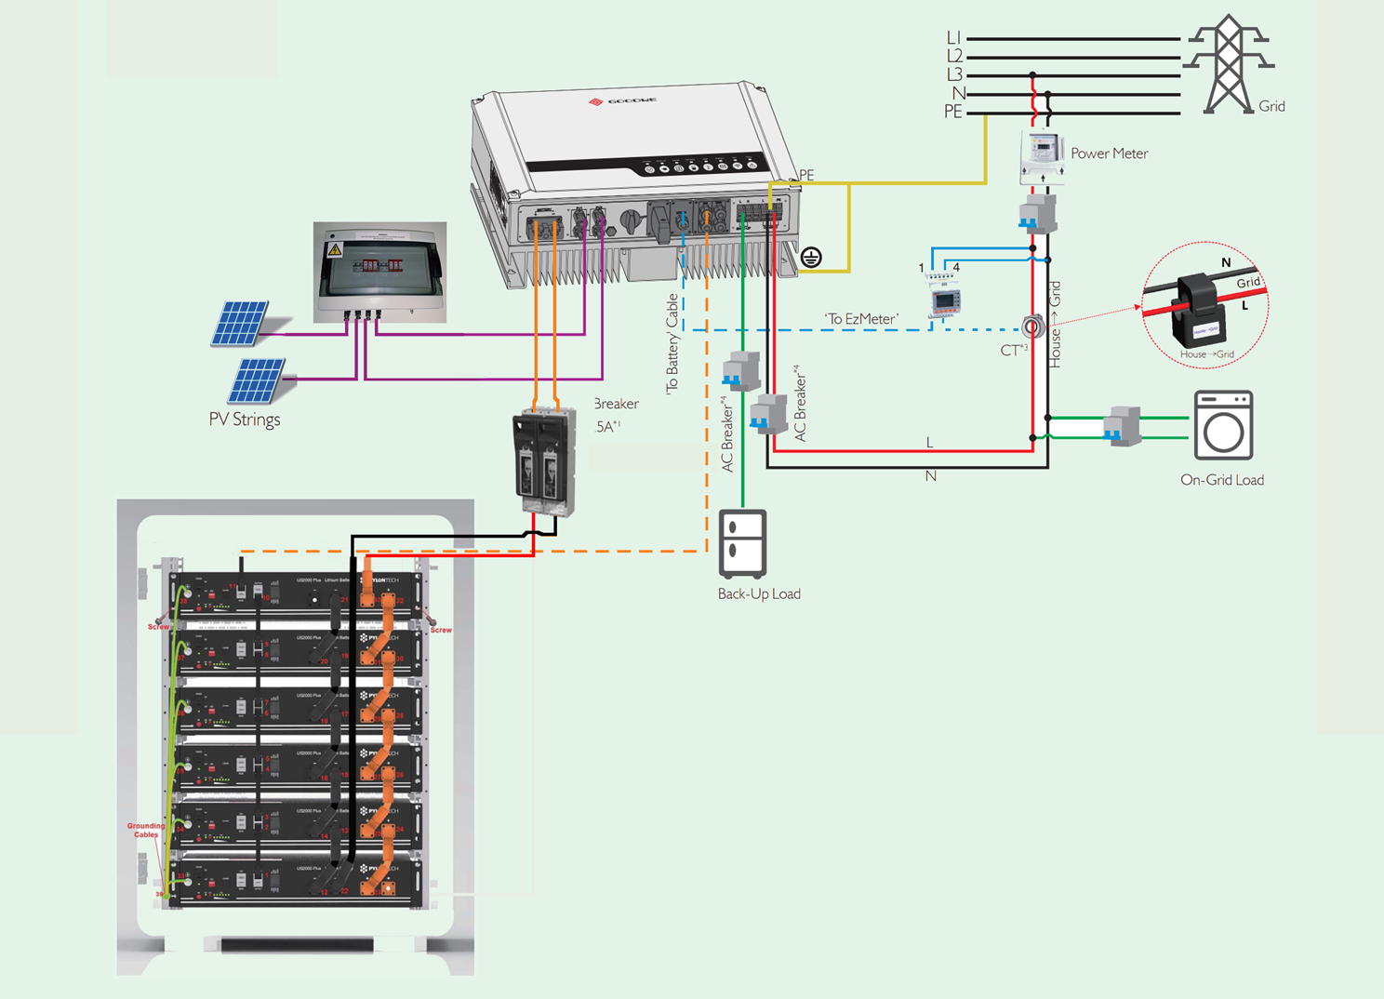
Lesson 6

Slide 57
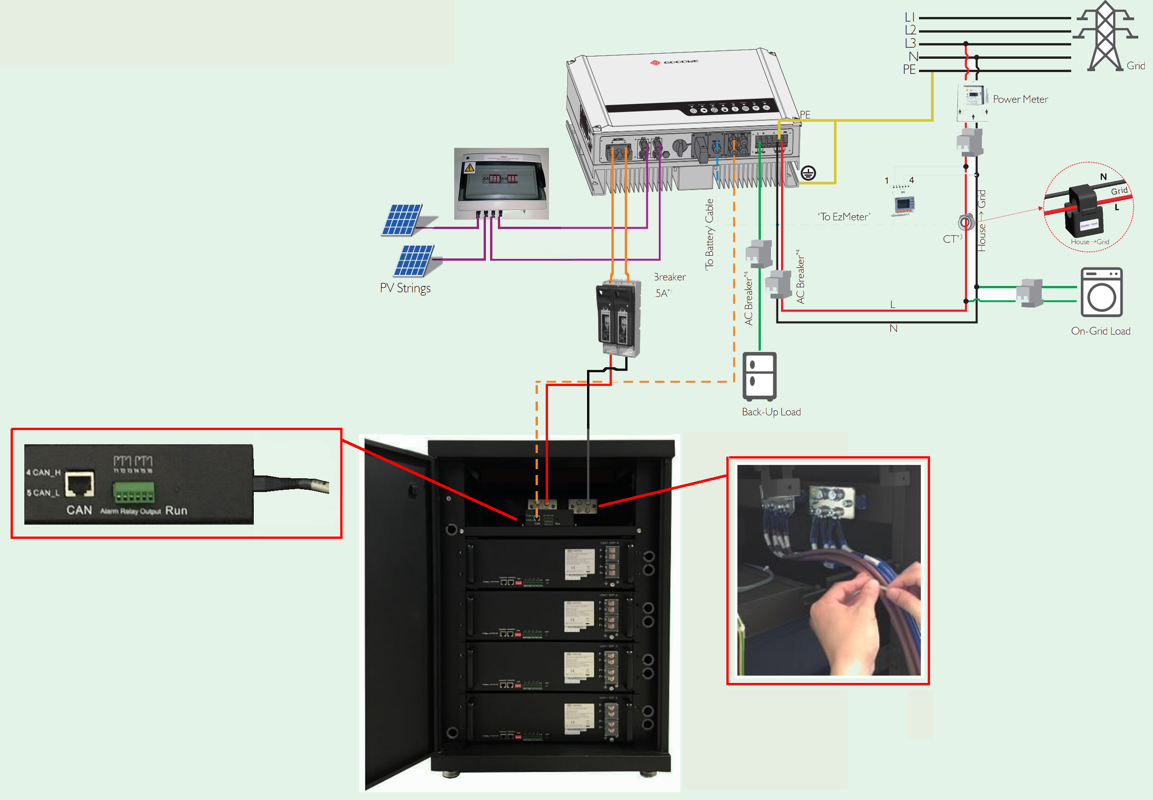
Lesson 6

Slide 58
Trouble shooting common issues
Unit reading export even though export is disabled.
Check CT direction
Check meter communication
Unit not communicating to batteries.
Check cable, must be plugged into CAN port
Check addressing switches
Check settings for correct battery selection
PV Master not connecting or getting setup failed message.
Ensure WiFi dongle firmware is latest version
Ensure PV master is latest version
Unit not connecting to WiFi, Sems portal showing “offline”
Inverter firmware and WiFi firmware should be updated with latest version

Slide 59
System Monitoring
http://www.goodwe-power.com/

Slide 60
Monitoring Platform

Slide 61
Station Overview

Slide 62
Register an Account
Select End User and complete the form.
Visitors will need to create an End User account

Slide 63
Add a Station
Station
Go into Plant Setup and add owner email

Slide 64
Add a Station
Station
Continue and complete the details, click submit
The system will then prompt to add a inverter to the plant

Slide 65
Add an Inverter
The Serial Number and Check Code will be required to register an inverter.
The Serial Number and Check Code can be found on the inverter name plate.

Slide 66
APP Monitoring

Slide 68
Installer Accounts
Contact SegenSolar for a installer account
Installer can view all connected installations

Slide 69
Pylon Application Note and Documents

Slide 70
Warranty extension
http://www.pylontech.com.cn/service/support

Slide 71
Warranty BYD
Complete form and submit to SegenSolar
https://portal.segensolar.co.za/reseller/docs/warranty_submission_ver.3.1_20170922.pdf

Slide 72
Product Warranty
STANDARD WARRANTY
GOODWE NS SS DS DT ES series inverters come standard with a manufacturer’s warranty of 66 months (5.5 years) from the date of production from JIANGSU GOODWE POWER SUPPLY TECHNOLOGY Co., Ltd (hereinafter referred to as GOODWE).
The accessory products include Antenna, EzConverter, EzMeter and EzLogger come standard with a manufacturer’s warranty of 30 months (2.5 years) from the date of manufacturing from GOODWE.
For inverters (GOODWE NS SS DS DT ES series), and the accessory products, the warranty can be extended within 24months (2 years) from the date of manufacturing. Please obtain the warranty extension price list form GOODWE Sales for further information.

Slide 73
Thank you!
The End

